Slide 1
ICS 432 – 01 Distributed and Cloud Computing Fall 2021
Instructor: Thanaa Ghanem
thanaa.ghanem@metrostate.edu
Lectures 12
November 13, 2021

Slide 2
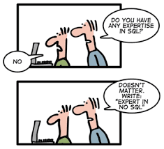

Slide 3
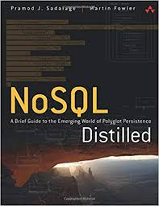
Lecture 12: NoSQL Systems
NoSQL Concepts
Reading:
NoSQL Distilled: A Brief Guide to the Emerging World of Polyglot Persistence (1st Edition).
Authors: Pramod J. Sadalage and Martin Fowler
Chapters 1, 2 and sections 3.1, 3.2, and 3.3.
NoSQL in AWS
Amazon DynamoDB
Exercise 2 in Lab 11
NoSQL in GCP
Firestore Document Database
Exercise 3 in Lab 11

Slide 4
Reading
NoSQL Distilled: A Brief Guide to the Emerging World of Polyglot Persistence (1st Edition).
By: Pramod J. Sadalage and Martin Fowler
Chapters:(link – read pages 18-40)
Chapter 1: Why NoSQL?
Chapter 2: Aggregate Data Models
Chapter 3: sections 3.1, 3.2, and 3.3

Slide 5
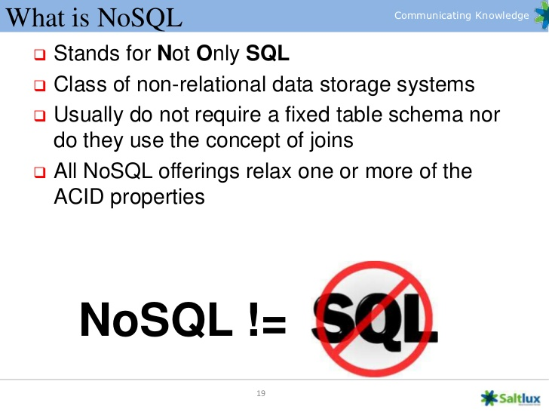

Slide 6
Example NoSQL Systems

Slide 7
Learning Objectives
The emergence of NoSQL to overcome the limitations of RDBMS for a certain type of applications.
Data Modeling for NoSQL systems.
Trading Consistency for Availability & the CAP theorem.
Amazon DynamoDB

Slide 8
Learning Objectives
The emergence of NoSQL to overcome the limitations of RDBMS for a certain type of applications.
Data Modeling for NoSQL systems.
Trading Consistency for Availability & the CAP theorem.
Amazon DynamoDB

Slide 9
Why NoSQL?
Relational Database Management Systems (RDBMS) have always been the default choice for serious data storage.
The values of RDBMS
Persistent Data
Concurrency
Integration
A (mostly) standard model
The limitations of RDBMS for a certain type of applications
Impedance mismatch
Restricted data model
Not built to run on a cluster

Slide 10
Values of RDBMS (1/4): Persistent Data
The most obvious value of a database is keeping large amounts of persistent data.
Main memory is both limited in space and loses all data when you lose power. To keep data, you have to write it to a backing store.
The backing store can be organized in many different ways (e.g., word document, excel sheet, or any file).
However, a database allows more flexibility than a file system in storing large amount of data in a way that allows an application to get information quickly and easily.

Slide 11
Values of RDBMS (2/4): Concurrency
Enterprise applications tend to have many people looking at the same body of data at once, possibly modifying that data.
If two persons are working on the same part of that data, we have to worry about coordinating these interactions to avoid such things as double booking of hotel rooms.
Enterprise applications always have lots of users and other systems all working concurrently, and hence there is a lot of room for bad things to happen.
RDBMs helps handle this by controlling all access to their data through transactions.

Slide 12
Values of RDBMS (3/4): Integration
Enterprise applications usually requires multiple applications, written by different teams, to collaborate in order to get things done.
In shared database integration, multiple applications store their data in a single database:
Hence allowing the applications to use each others’ data easily while the database concurrency control handles multiple users.

Slide 13
Values of RDBMS (4/4): A (mostly) standard model
Relational databases have succeeded because they provide the core benefits outlined earlier in a (mostly) standard way.
Developers can learn the basic relational model and apply it in many projects.
Although there are differences between relational databases, the core mechanisms remain the same:
Different vendors’ SQL dialects are similar, and transactions operate mostly in in the same way.

Slide 14
Limitations of RDBMS (1/3): Impedance Mismatch
Relational databases provide many advantages, but they are by no means perfect.
Impedance mismatch happens when two different representations require translation
There is a difference between the relational model and the in-memory data structures.
The relational data model organizes data into relations and tuples.
All operations in SQL consume and return relations/tables
Mathematically elegant relational algebra.
Although the foundation of relations provides a certain elegance and simplicity, but it also introduces limitations.
Notes:
Impedance: Something that impedes, hindres or obstacle

Slide 15
Example on Impedance Mismatch

Slide 16
An early solution to Impedance Mismatch
Impedance mismatch has been much easier to deal with by the wide availability of Object-relational mapping frameworks (e.g., Hibernate).
Object relational mapping frameworks remove a lot of work but can become a problem of their own when people try too hard to ignore the database and, hence, the query performance suffers.
The heart of the problem involves translating the logical representation of the objects into an atomized form that is capable of being stored in the database while preserving the properties of the objects and their relationships so that they can be reloaded as objects when needed.

Slide 17

Growth in unstructured data
“In 2017, we surveyed 200 of our customers and others and they told us that their unstructured data is growing between 40-60% per year, and this is faster growth than any other business data they have. They identified top growing data types as being rich media – audio, video, images, and research data – all of which are non-text data types. They also identified IoT data as being a growing part of their unstructured data. This is leading to an explosion of unstructured data due [to] the increased size and volume of these data types.”
Stefaan Vervaet, Sr. Director Solutions Marketing, Data Center Systems
Notes:
Traditionally, digital data was structured data—that is, data that could be structured into columns and rows, and stored in a relational database. However, according to a 2017 survey conducted by 451 Research and sponsored by Western Digital, unstructured data is growing between 40–60 percent per year. This growth is due to the increased size and volume of unstructured data types, such as audio, video, images, research data, and Internet of Things (IoT) data. (Source: https://blog.westerndigital.com/2018-data-trends-today-tomorrow-change/)
Additional reading: https://datascience.berkeley.edu/structured-unstructured-data/

Slide 18
Limitations of RDBMS (2/3) : Restricted Data Model
The relational model divides information into tuples (rows):
A tuple is a limited data structure as it captures a set of values but:
you cannot nest one tuple within another to get nested records
you cannot put a list of values or tuples within another
RDBMS are not optimized to manage unstructured data.
Sometimes it may be helpful to operate on data in units that have a more complex structure than a set of tuples.
Aggregate orientation is used to refer the concept of allowing lists and other record structures to be nested inside a tuple.

Slide 19
Attack of the Cluster
The 2000s did see several large web properties dramatically increase in scale.
Web sites started tracking activity and structure in a very detailed way
Large sets of data appeared: links, social networks, activity in logs, and mapping data.
Biggest websites grew to be vast estates regularly serving huge number of visitors.
Coping with the increase in data traffic required more computing resources.
Scaling up or out
A cluster of small machines can use commodity hardware and ends up being cheaper at these kinds of scales.
Reliability and fault tolerance are required for clusters.

Slide 20
Limitations of RDBMS (3/3): Not built to run on Clusters
Relational databases are not designed to be run on clusters
Distributed relational databases work on the concept of a shared disk subsystem which means the cluster still has the disk as a single point of failure.
Relational databases could also be run as separate servers for different sets of data (sharding)
All the sharding has to be controlled by the application which has to keep track of which database server to talk to for each bit of data.
Lose any querying, referential integrity, transactions, or consistency control across shards.

Slide 21
The emergence of NoSQL
The mismatch between relational databases and clusters led some organizations to consider an alternative route to data storage.
Google and Amazon were on the forefront of running large clusters, furthermore, they were capturing huge amounts of data.
As the 2000s drew on, both companies produced brief but highly influential papers about their efforts:
BigTable from Google (2006).
Dynamo from Amazon (2007).

Slide 22
The emergence of NoSQL (continued)
More organizations are beginning to explore what they can do by capturing and processing more data.
People began to explore making databases explicitly designed to live in a world of clusters

Slide 23
The Emergence of NoSQL (continued)
The usage of the term “NoSQL” trace back to a meetup on June 11, 2009 in San Francisco organized by a software developer, Johan Oskarsson, based in London.
The examples of BigTable and DynamoDB has inspired a bunch of projects experimenting with alternative data storage.
Johan wanted a name for the meetup – something that would make a good Twitter hashtag, short, memorable, and hence the name “NoSQL” was chosen.
The name has the disadvantage of being negative and not really describing these systems that are ”open source, distributed, non-relational databases”
Discussions about this topic had become a feature of many of software conferences around that time.

Slide 24
Google’s BigTable: paper abstract
Bigtable is a distributed storage system for managing structured data that is designed to scale to a very large size: petabytes of data across thousands of commodity servers.
Many projects at Google store data in Bigtable, including web indexing, Google Earth, and Google Finance.
These applications place very different demands on Bigtable, both in terms of data size (from URLs to web pages to satellite imagery) and latency requirements (from backend bulk processing to real-time data serving).
Despite these varied demands, Bigtable has successfully provided a flexible, high-performance solution for all of these Google products.
In this paper we describe the simple data model provided by Bigtable, which gives clients dynamic control over data layout and format, and we describe the design and implementation of Bigtable.

Slide 25
Overview of Bigtable
Bigtable is a sparsely populated table that can scale to billions of rows and thousands of columns, enabling you to store terabytes or even petabytes of data.
A single value in each row is indexed; this value is known as the row key.
It supports high read and write throughput at low latency, and it is an ideal data source for MapReduce operations.
Notes:
https://cloud.google.com/bigtable/docs/overview

Slide 26
What is Bigtable good for?
Bigtable is ideal for applications that need very high throughput and scalability for key/value data, where each value is typically no larger than 10 MB.
You can use Bigtable to store and query all of the following types of data:
Time-series data, such as CPU and memory usage over time for multiple servers.
Marketing data, such as purchase histories and customer preferences.
Financial data, such as transaction histories, stock prices, and currency exchange rates.
Internet of Things data, such as usage reports from energy meters and home appliances.

Slide 27
Amazon DynamoDB: paper abstract
Reliability at massive scale is one of the biggest challenges we face at Amazon.com:
even the slightest outage has significant financial consequences and impacts customer trust.
The Amazon.com platform, which provides services for many web sites worldwide, is implemented on top of an infrastructure of tens of thousands of servers and network components located in many datacenters around the world.
small and large components fail continuously and the way persistent state is managed in the face of these failures drives the reliability and scalability of the software systems.
This paper presents the design and implementation of Dynamo, a highly available key-value storage system that some of Amazon’s core services use to provide an “always-on” experience.
To achieve this level of availability, Dynamo sacrifices consistency under certain failure scenarios.

Slide 28
Amazon DynamoDB use cases
Duolingo case study
Duolingo uses Amazon DynamoDB to store 31 billion items in support of an online learning site that delivers lessons for 80 languages. The US startup reaches more than 18 million monthly users around the world who perform more than six billion exercises using the free Duolingo lessons. The company relies heavily on Amazon DynamoDB for its highly scalable database and also for its high performance, which reaches 24,000 read units per second and 3,300 write units per second.
Serverless web applications
Microservices data store
Mobile backends
Adtech
Gaming
Internet of Things
Notes:
AWS customers in a wide variety of industries use Amazon DynamoDB to store mission-critical data. Financial services, commerce, adtech, IoT, and gaming applications (to name a few) make millions of requests per second to individual tables that contain hundreds of terabytes of data and trillions of items, and they count on DynamoDB to return results in single-digit milliseconds.
There are several use cases for Amazon DynamoDB :
Serverless web applications – Build powerful web applications that automatically scale up and down. You don't need to maintain servers, and your applications have automated high availability.
Microservices data store – Build flexible and reusable microservices using DynamoDB as a serverless data store for consistent and fast performance.
Mobile backends – Build personalized mobile apps with smooth experiences for your users. DynamoDB takes care of operational tasks so that you can focus on your applications.
Adtech – Create real-time bidding platforms and recommendation engines with the scalability, throughput, and availability of DynamoDB.
Gaming – Create responsive games for mobile, console, and desktop with DynamoDB. Store and query game data such as player state, high scores, or world dynamic content.
Internet of Things (IoT) – Analyze your devices by connecting your high-velocity, high-volume IoT data in DynamoDB to Amazon Redshift and Amazon QuickSight.
Duolingo case study
Duolingo is a free language-learning platform that includes a language-learning website and app. Duolingo uses Amazon DynamoDB to store 31 billion items in support of an online learning site that delivers lessons for 80 languages. The US startup reaches more than 18 million monthly users around the world, who perform more than six billion exercises using the free Duolingo lessons. The company relies heavily on Amazon DynamoDB for its highly scalable database and also for its high performance, which reaches 24,000 read units per second and 3,300 write units per second. Read the case study: https://aws.amazon.com/solutions/case-studies/duolingo-case-study-dynamodb/

Slide 29
Common Characteristics of NoSQL databases
Don’t use SQL:
Some systems has languages that are similar to SQL (e.g., Cassandra’s CQL)
None have implemented anything that would fit even the rather flexible notion of Standard SQL.
Open-source projects
Driven by the need to run on clusters:
This has an effect on their data model as well as their approach to consistency.
ACID clashes with cluster environment
NoSQL systems offer a range of options for consistency and distribution.
Graph databases are the only NoSQL systems that offers a distribution model similar to RDBMS but offers a different data model.
Operate without a schema (schemaless):
You can freely add fields to database records without having to first define any changes in structure.
This is useful when dealing with non-uniform data and custom fields.

Slide 30
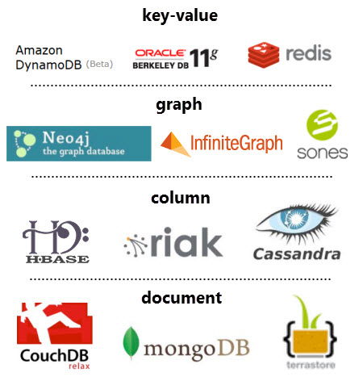
Categories of NoSQL Systems
NoSQL data models can be categorized into four main categories:
Key-value
Document
Column-family
graph

Slide 31
Schema-less Databases
A common theme across all the forms of NoSQL databases is that they are schemaless.
In RDMS, you must define the schema (i.e., tables, columns data types) before storing any data.
In NoSQL, storing data is more casual:
Key-value stores: store any data you like under a key.
Document stores: no restrictions on the structure of the documents you store.
Column-family: store any data under any column you like.
Graph databases: you can freely add new edges and add properties to nodes and edges.
Schema-less gives you freedom and flexibility in data modeling:
change your data storage as you learn more about your project.
deal with non-uniform data in which each record has a different set of fields.

Slide 32
Problems with Schema-less systems (1): writing code to operate on the data
We must make operations on our data using programs that need to know, for example, that:
‘the billing address’ is called billingAddress and not addressForBilling.
quantity field is an integer 5 and not five
Programs are not humans, and they cannot infer that ‘qty’ must be the same as ‘quantity’.
There is usually an implicit schema that is basically a set of assumptions about the structure of the data in the code that manipulates the data.
You need to dig into the application code in order to know the schema.
A schemaless database shifts the schema into the application code that accesses it.

Slide 33
Problems with schema-less systems (2): the system cannot optimize query performance
The database remains ignorant of the schema and hence it cannot use the schema to help it decide how to store and retrieve the data efficiently.
The database system cannot apply its own validations to ensure that different applications don’t manipulate data in inconsistent way.
A schema-less database shift the schema into the application code that accesses it.
This becomes problematic if different applications written by different people are to access the same data.

Slide 34
SQL vs. NoSQL Systems
Database Model | Relational | NoSQL
Other names | RDBMS, SQL-based | Non-relational, distributed
Storage model | Table | Key-value, document, column, graph
Schema | Predefined for structured data: schema-on-write | Dynamic for unstructured data: schema-on-read
Scalability | Vertical: increase horsepower | Horizontal: increase servers
Language | SQL: complex and powerful | UnQL (Unstructured Query Language): the syntax varies depending on the database
DBMS | MySQL, Oracle, SQLite, Postgres | MongoDb, Bigtable, Redis, RavenDb, Cassandra, HBase, Neo4j and CouchDb
Data types | Best fitted for traditional structured data | Best fitted for big (semi-structured/unstructured) data
Goal | Mostly operational and transactional | Mostly data analysis
Data integrity | Follows ACID compliance | Follows Brewer's CAP theorem

Slide 35
Relational versus non-relational databases
 | Relational (SQL) | NoSQL
Data Storage | Rows and columns | Key-value, document, graph
Schemas | Fixed | Dynamic
Querying | Uses SQL | Focuses on collection of(JSON) documents
Scalability | Vertical | Horizontal
Example
ISBN | Title | Author | Format
3111111223439 | Withering Depths | Jackson, Mateo | Paperback
3122222223439 | Wily Willy | Wang, Xiulan | Ebook
{
ISBN: 3111111223439,
Title: “Withering Depths”,
Author: ”Jackson, Mateo”,
Format: “Paperback”
}
Notes:
With DynamoDB, this module transitions from relational databases to non-relational databases. Here is a review of the differences between these two types of databases:
A relational database (RDB) works with structured data that is organized by tables, records, and columns. RDBs establish a well-defined relationship between database tables. RDBs use structured query language (SQL), which is a standard user application that provides a programming interface for database interaction. Relational databases might have difficulties scaling out horizontally or working with semistructured data, and might also require many joins for normalized data.
A non-relational database is any database that does not follow the relational model that is provided by traditional relational database management systems (RDBMS). Non-relational databases have grown in popularity because they were designed to overcome the limitations of relational databases for handling the demands of variable structured data. Non-relational databases scale out horizontally, and they can work with unstructured and semistructured data.
Here is a look at what DynamoDB offers.

Slide 36
CRUD operations
Create, Read, Update, and Delete (CRUD) are the four basic operations of persistent storage.
The acronym CRUD refers to the major operations which are implemented by databases.
Each NoSQL system has its own language
CRUD | SQL | DynamoDB | MongoDB
Create | INSERT | put_item | insertOne(), insertMany()
Read | SELECT | get_item, query, scan | find()
Update | UPDATE | update_item | updateOne(), updateMany()
Delete | DELETE | delete_item | deleteOne(), deleteMany()

Slide 37
Polyglot persistence
Relational databases are now only one option for data storage.
Polyglot persistence is a term that refers to using multiple data storage technologies for varying data storage needs across an application or within smaller components of an application.
Polyglot means containing, composed of, or written in several languages (multilingual)
You need to understand the nature if the data you are storing and how you want to manipulate it.
Most organizations will have a mix of data storage technologies for different circumstances.
Organizations need to shift from integration database to application database.

Slide 38
Important Notes
NoSQL is commonly used to refers to a set of mostly open-source databases, mostly developed in the early 21st century and mostly not using SQL.
Think of NoSQL as a movement rather than a technology.
Relational databases are NOT going away – they are still going to be the most common form of database in use:
Their familiarity, stability, feature set, and available support are compelling arguments for most projects.

Slide 39
Conclusions
Two primary reasons for considering NoSQL:
Big (unstructured) data: handle data access with sizes and performance that demand a cluster.
Impedance mismatch: improve the productivity of application development by using more convenient data interaction style.
These primary reasons have created an opportunity for people to think freshly about their data storage needs:
Using NoSQL database can help teams’ productivity by simplifying database access even if they have no need to scale beyond a single machine.

Slide 40
Learning Objectives
The emergence of NoSQL to overcome the limitations of RDBMS for a certain type of applications.
Data Modeling for NoSQL systems.
Trading Consistency for Availability & CAP theorem.
Amazon DynamoDB

Slide 41
Data Modeling
A data model is the model by which the database organizes data.
A storage model describes how the database stores and manipulates the data internally.
In an ideal world, we should be ignorant to the storage model, but in practice we need at least some inkling of it primarily to achieve decent performance.
Notes:
Inkling: hint, a slight suggestion or indication

Slide 42
Data Modeling (continued)
The dominant data model of the last couple of decades is the relational data model:
Set of tables, each table has rows, where each row represents an entry of interest.
The entity of interest is described through a set of columns, each has a single value.
There are relationships between tables (foreign keys).
NoSQL systems move away from the relational model.
Each NoSQL system has a different data model that is uses

Slide 43
Limitations of the Relational Data Model
The relational model divides information into tuples (rows):
A tuple is a limited data structure as it captures a set of values but:
you cannot nest one tuple within another to get nested records
you cannot put a list of values or tuples within another
Sometimes it may be helpful to operate on data in units that have a more complex structure than a set of tuples.
Aggregate orientation is used to refer the concept of allowing lists and other record structures to be nested inside a tuple.

Slide 44
Aggregate Data Model
Aggregate data model recognizes the fact that often you need to operate on data units that have more complex data structure than a set of tuples.
allow lists and other records to be nested inside a tuple.
Aggregate is a collection of related objects that we wish to treat as a unit.
A unit for data manipulation and management for consistency.
Dealing with aggregate makes it much easier to operate on a cluster since aggregate makes a natural unit for replication and sharding.

Slide 45
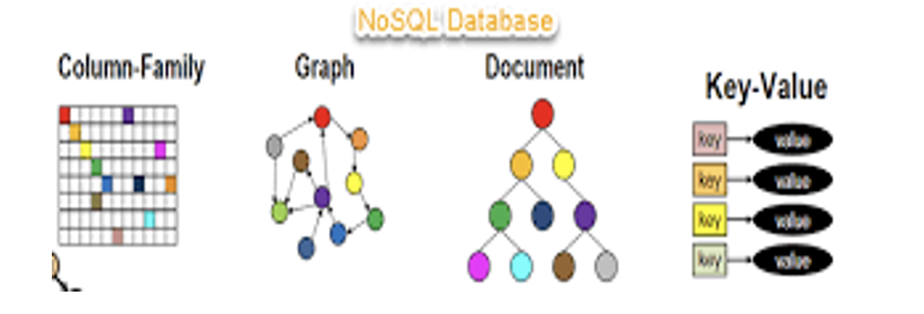
NoSQL Data Models
NoSQL Systems are categorized based on their data models:
Key-value
Document
Column-family
graph

Slide 46
Examples of Relations vs. Aggregates
Consider an application about an e-commerce website that needs to store information about:
users
products
orders
billing and shipping addresses
payment data
This application can be implemented using either a SQL or NoSQL data storage system.

Slide 47
RDBMS implementation

Slide 48
An example database in RDBMS

Slide 49
Notes on the RDBMS implementation
Everything is properly normalized so that no data is repeated in multiple tables
Referential integrity is used to combine data from different tables.
Join is the most expensive operation to implement in a RDBMS

Slide 50
Aggregate-oriented implementation
The black-diamond composition marker is used to show how data fits into the aggregation structure.
Customer aggregate contains a list of billing addresses
Order aggregate contains a list of order items, a shipping address, and payments
Payment aggregate contains a billing address for that payment.

Slide 51
An example data in aggregate-orientation
Note that a single logical address record appears three times in the example data
But instead of using IDs, it is treated as a value and copied each time
This fits the domain where we would not want the shipping address, nor the payment’s billing address to change.
In a relational database, one row is used for address
The link between the Customer and Order isn’t within any aggregate.
it is a relationship between aggregates.

Slide 52
Developing aggregate-oriented data models
Design for data access: you have to think about accessing the data and make that part of your decisions when developing the application data model.
Aggregate boundaries could have been drawn differently by putting all orders for a customer into the Customer aggregate.
If you are going to access a Customer along with all the customer’s orders at once, then you would prefer a single aggregate.
If you are going access a single Order at a time, then you should prefer having separate aggregates for each order.

Slide 53
Another aggregate-oreitned design

Slide 54
Consequences of Aggregate Orientation
When working with aggregate-oriented databases, we have a clearer semantics to consider by focusing on the unit of interaction with the data storage.
However, it is not a logical property: it is all about how the data is being used by the application – a concern that is often outside the bounds of data modeling.
RDMSs are aggregate-ignorant: it is often difficult to draw aggregate boundaries well, particularly if the same data is used in many different contexts.

Slide 55
Choosing an aggregate-oriented design
Should we have an Order aggregate with products inside it?
Yes, this design is useful if a customer is making and reviewing orders and when the retailer is processing orders.
No, this design will not be so good when the retailer wants to analyze its product sales over the last few months:
To get product sales history, you will have to dig into each aggregate in the database

Slide 56
Concluding notes on aggregate data models
Aggregate-ignorant model are useful when you need to look at the data in different ways and you do not have a primary structure for manipulating your data.
Aggregate-oriented models helps greatly when running queries on a cluster to minimize how many cluster nodes to access to when gathering data
Aggregate-oriented databases do not support ACID transactions that span multiple aggregates:
Instead, they support atomic manipulation of single aggregate at a time.
If you need to manipulate multiple aggregates in an atomic way, this must be done at the application level.

Slide 57
Key-value and Document data models
Both systems are strongly aggregate oriented.
They differ in that:
Key-value models: the aggregate is opaque to the database – just some big blob of meaningless bits
Disadvantage: you can only access one whole aggregate at a time.
Advantage: you can store whatever you like
Document models: you are able to see and query the structure in the aggregate
Disadvantage: the system has to define allowable structures and types
Advantage: you get more flexibility in access as you can write queries based on parts of the aggregate. You can also create indexes.
Notes:
opaque: transparent

Slide 58
Column-Family stores
The column-family model is a two-level aggregate structure.
The first key (row-identifier) is used to pick up the aggregate of interest.
This row aggregate is itself formed of a map of more detailed values.
The second-level values are referred to as columns
Operations can access a row as a whole, or you may also pick a particular column.
Example:
To get customer’s name, use (‘1234’,’name’)

Slide 59
Column-family stores (continued)
Column family databases organizes their columns into column families where each column has to be part of a single column family.
There is an assumption that the data for a particular column family will be usually accessed together. However, a column acts as unit for access.
You can add column to any row, and rows can have very different column keys
New columns can be added to rows during regular database access, however, defining new column families is rare and may involve stopping the database for it to happen.

Slide 60
The difference between column-family and document database is that column-family databases use information about column grouping for its storage and access decisions.
Although a document database declares some structure to the database, each document is still a single unit.

Slide 61
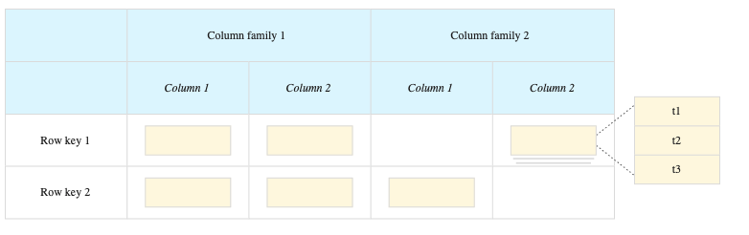
Bigtable Storage Model
Bigtable stores data in massively scalable tables, each of which is a sorted key/value map
The table is composed of:
rows, each of which typically describes a single entity, and
columns, which contain individual values for each row.
Each row is indexed by a single row key.
Columns that are related to one another are typically grouped together into a column family.
Each row/column intersection can contain multiple cells. Each cell contains a unique timestamped version of the data for that row and column.

Slide 62
Bigtable Example

Slide 63
Relationships
If you have data with a lot of relationships, then a RDBMS is preferred over a NoSQL
However, joins are also a main obstacle in relational databases, and it can cause performance degradation.
Graph Databases are an odd fish in the NoSQL pond since it motivated by small records with complex interconnections (not big data nor clusters).
Mostly used to represent graphs in ’social networks’ or ‘product preferences’
Why Graph databases are categorized as NoSQL? because of the rejection of the relational data model

Slide 64
An example of a Graph Database
In the shown graph, the nodes a very small (just a name):
A node can be either:
Book title
Category
Person name
Publisher name
But there is a rich structure of interconnections between them.
A relationship can be:
Person Likes Book
Person Employee at publisher
Person Friend with Person
Person Author Book
Example query:
Find the books in the database category that are written by someone whom a friend of mine likes.

Slide 65
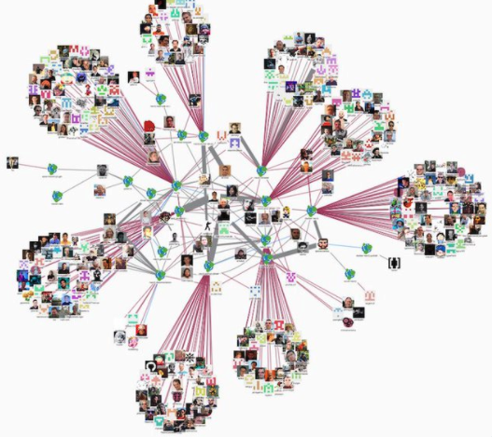
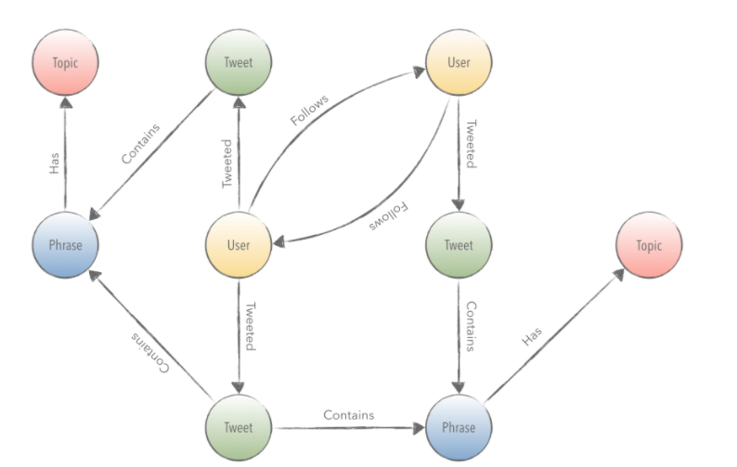
Another example for Graph databases: Twitter Data

Slide 66
Difference between RDBM and Graph databases
RDBMS can implement relationships using foreign keys, however, join required to do that can get expensive which means performance is often poor for highly connected data models.
Graph databases make traversal along the relationships very efficient:
Graph database shifts the time to represent connections to insert time instead of query time
This is useful when query performance is more important than insert speed.
Most of the query work to be navigating relationships.

Slide 67
Summary of Aggregate-Oriented Databases
Aggregate-oriented data models share the notion of an aggregate indexed by a key that can be used for look up.
The aggregate acts as the atomic unit for updates (limited amount of transactional control) or distribution on the cluster.
The aggregate is central to running on a cluster, as the database will ensure that all the data for an aggregate is stored together on one node.

Slide 68
Summary of Aggregate-Oriented Databases (continued)
Key-values model: treats the aggregate as an opaque whole, which means you can only do key lookup for the whole aggregate – you cannot run a query nor retrieve a part of the aggregate.
Document model: makes the aggregate transparent to the database allowing you to do queries and partial retrievals.
The document has no schema, and hence the database cannot do much on the structure to optimize the storage and retrieval of parts of the aggregate
Column-family model: divides the aggregate into column families, allowing the database to treat them as units of data within the row aggregate:
This imposes some structure on the aggregate and allows the database to take advantage of that structure to improve its accessibility.

Slide 69
Choosing a database service
Choosing the right database service requires a good understanding of both the capabilities of the service and the needs of the application.
Database workload factors to consider:
Structure
Compute
Cost
Access patterns
Performance
Size
Choose a database engine based on:
Purpose
Application needs
Notes:
Choosing the right database service requires a good understanding of both the capabilities of the service and the needs of the application. For example, some database engines use the relational model, and are well-suited for transactional applications. Other database engines conform to the NoSQL model and are intended for internet-scale applications. Still others are ideal for real time workloads that require an in-memory data store for caching.
Therefore, it is important to match the requirements of the application workload with the capabilities of the database service. Some key workload characteristics to consider include the shape of the data, its size and computational requirements, and its access patterns and performance needs. These factors can assist you in finding the right database for your needs.

Slide 70
AWS database recommendations
If You Need | Product Type | Consider Using
Managed relational database that is launched with a choice of six popular database engines | Relational database | Amazon RDS
MySQL- and PostgreSQL-compatible relational database built for the cloud | Relational database | Amazon Aurora
Fully managed NoSQL database | NoSQL database | Amazon DynamoDB
Managed graph database | NoSQL database | Amazon Neptune
Managed Redis key-value store | NoSQL database | Amazon ElastiCache
Columnar storage SQL data warehouse | Relational database | Amazon Redshift
Notes:
This table lists the general recommendations for when to use which type of AWS database. The key takeaway is that AWS offers a broad range of databases that are purpose-built for specific application use cases. These fully managed database services include relational databases for transactional applications, non-relational databases for internet-scale applications, a data warehouse for analytics, an in-memory data store for caching and real-time workloads, and a graph database for building applications with highly connected data.

Slide 71
Learning Objectives
The emergence of NoSQL to overcome the limitations of RDBMS for a certain type of applications
Data Modeling for NoSQL systems.
Trading Consistency for Availability & the CAP theorem.
Amazon DynamoDB

Slide 72
Introduction to consistency
One of the biggest differences a centralized relational database to a cluster-oriented NoSQL database is in how you think about consistency.
Relational databases exhibit strong consistency by avoiding all the various inconsistencies (using ACID).
The NoSQL world define new relaxed consistency measures, for example, eventual consistency.

Slide 73
Replication and Inconsistency

Slide 74
Eventual Consistency
Eventual consistency means that, at any point in time, nodes may have replication inconsistencies but, if there are no further updates, eventually all nodes will be updated to the same value.
Data that is out of date is generally referred to as stale.
Consistency guarantees aren’t something that’s global to an application.
You can usually specify the level of consistency you want with individual requests.
This allows you to use weak consistency most of the time when it isn’t an issue but request strong consistency when it is.

Slide 75



Eventual Consistency- A Facebook Example (1/3)
Bob finds an interesting story and shares with Alice by posting on her Facebook wall
Bob asks Alice to check it out
Alice logs in her account, checks her Facebook wall but finds:
- Nothing is there!
?

Slide 76

Eventual Consistency- A Facebook Example (2/3)
Bob tells Alice to wait a bit and check out later
Alice waits for a minute or so and checks back:
- She finds the story Bob shared with her!

Slide 77
Eventual Consistency- A Facebook Example (3/3)
Facebook uses an eventually consistent model
Why Facebook chooses eventual consistent model over the strong consistent one?
Facebook has more than 1 billion active users
It is non-trivial to efficiently and reliably store the huge amount of data generated at any given time
Eventual consistent model offers the option to reduce the load and improve availability

Slide 78



Eventual Consistency - A Dropbox Example (1/2)
Dropbox enables immediate consistency via synchronization in many cases.
However, what happens in case of a network partition?

Slide 79
Eventual Consistency - A Dropbox Example (2/2)
Let’s do a simple experiment here:
Open a file in your drop box
Disable your network connection (e.g., WiFi, 4G)
Try to edit the file in the drop box: can you do that?
Re-enable your network connection: what happens to your Dropbox folder?
Dropbox embraces eventual consistency:
Immediate consistency is impossible in case of a network partition
Users will feel bad if their word documents freeze each time they hit Ctrl+S , simply due to the large latency to update all devices across the network.

Slide 80

Eventual Consistency- An ATM Example
In Automated Teller Machine (ATM):
Strong consistency appear to be a nature choice
However, in practice, Availability beats Consistency
Higher availability means higher revenue
ATM will allow you to withdraw money even if the machine is partitioned from the network
However, it puts a limit on the amount of withdraw (e.g., $200).
The bank might also charge you a fee when an overdraft happens.

Slide 81
Session consistency
Issue:
Consider the example of posting comments on a blog entry.
Systems usually handle the load of such sites by running on a cluster and load-balancing incoming requests to different nodes.
There lies a danger: you may post a message using one node, then refresh your browser, but the refresh goes to a different node which hasn’t received your post yet—and it looks like your post was lost
Session consistency means that within a user’s session there is read-your-writes consistency.
This does mean that the user may lose that consistency should their session end.

Slide 82
Relaxing Consistency
Supporting consistency is a good thing but it is expensive too.
Systems often have to tradeoff consistency for availability.
Different domains have different tolerances for inconsistency, and we need to take this tolerance into account as we make our decisions.
Even transaction systems usually come with the ability to relax isolation levels:
allowing queries to read data that hasn’t been committed yet, and in practice we see most applications relax consistency down from the highest isolation level (serialized) in order to get effective performance

Slide 83
Relaxing Consistency (continued)
There are cases where you can deal gracefully with inconsistent answers to requests.
These situations are closely tied to the domain and require domain knowledge to know how to resolve.
If you can find a way to handle inconsistent updates, this gives you more options to increase availability and performance.
If you are trading financial instruments over a computerized exchange, you may not be able to tolerate any data that isn’t right up to date.
However, if you are posting a news item to a media website, you may be able to tolerate old pages for minutes.

Slide 84
The need for Relaxed Consistency
Many websites liked the high speed of NoSQL and were prepared to live without transactions.
Some very large websites, such as eBay, have had to forgo transactions in order to perform acceptably.
Many application builders need to interact with remote systems that can’t be properly included within a transaction boundary, so updating outside of transactions is a quite common occurrence for enterprise applications.

Slide 85
Trading off consistency and availability
Distributed systems involves a fundamental tradeoff between:
Safety: avoiding errors such as update conflicts
Liveness: responding quickly to clients.
Pessimistic approaches guarantees safety but:
degrade the responsiveness of a system to the degree that it becomes unfit for its purpose.
often leads to deadlocks, which are hard to prevent and debug.

Slide 86
Trading off consistency for availability (continued)
When you work in a cluster, then data is replicated to ensure reliability.
Replication raises the issue of to ensure consistency among the replicas.
If consistency has a higher priority:
The replicas can coordinate to avoid a conflict.
There is a cost of network traffic to coordinate the writes.
Maybe we do not need all the replicas to agree on the write, just a majority, so we can still survive losing a minority of the replica nodes.
If availability has a higher priority:
we can decide to cope with an inconsistent write.
Then come up with policy to merge inconsistent writes.
In this case, we can get the full performance benefit of writing to any replica.

Slide 87
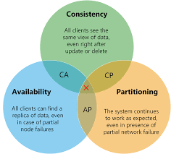
Introducing the CAP Theorem
Prof. Eric Brewer introduced the CAP theorem at the Principle of Distributed Computing conference in 2000.
Described the trade-offs involved in distributed system
It is impossible for a web service to provide following three guarantees at the same time:
Consistency
Availability
Partition-tolerance

Slide 88
Consistency (C)
All client programs that are reading the data from the cluster see the same, most recent data possible
If the data in some nodes are updated and in one or more other nodes are not updated yet
The system is not consistent
If the system sends an error to the client indicating that data is not up to data, the system can still be considered to be consistent

Slide 89
Availability (A)
The client programs should be able to read and retrieve the data even if the information may not be consistent

Slide 90
Partition Tolerance (P)
The cluster continues to function even if:
One or more nodes go down
There is a communication failure between two given nodes
Network failure occurs when all nodes are down or fail to communicate

Slide 91
The CAP Theorem
Given the three properties of Consistency, Availability, and Partition tolerance, you can only get two: CA, CP, or AP
In practice what it’s saying is that in a system that may suffer partitions, as distributed systems do, you have to trade off consistency versus availability.

Slide 92
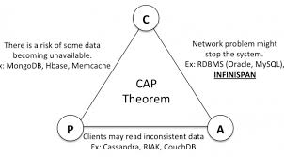
CAP theorem explained
CA: a single-server system is the obvious example of a CA system
a system that has Consistency and Availability but not Partition tolerance.
E.g., Relational Databases
CP: wait for a response from the partitioned node which could result in a timeout error.
The system can also choose to return an error, depending on the scenario you desire.
Choose Consistency over Availability when your business requirements dictate atomic reads and writes.
AP: return the most recent version of the data you have, which could be stale.
This system state will also accept writes that can be processed later when the partition is resolved.
Choose Availability over Consistency when your business requirements allow for some flexibility around when the data in the system synchronizes.
Availability is also a compelling option when the system needs to continue to function in spite of external errors (shopping carts, etc.)

Slide 93
Example on applying the theorem
Martin and Pramod are both trying to book the last hotel room on a system with two nodes (London for Martin and Mumbai for Pramod).
If we want to ensure consistency, then when Martin tries to book his room on the London node, that node must communicate with the Mumbai node before confirming the booking.
To ensure consistency, both nodes must agree on the serialization of their requests.
But should the network link break, then neither system can book any hotel room, sacrificing availability.
To gain more availability, we might allow both systems to keep accepting hotel reservations even if the network link breaks down.
The danger here is that Martin and Pramod book the last hotel room.
However, depending on how this hotel operates, that may be fine.
Often, travel companies tolerate a certain amount of overbooking in order to cope with no-shows.

Slide 94

CAP Theorem Example
Hotel Booking: are we double-booking the same room?
Bob
Dong

Slide 95
CAP Theorem Example
Hotel Booking: are we double-booking the same room?
No, we prefer consistency, then both users will wait for the network partition to be resolved
Bob
Dong

Slide 96

CAP Theorem
Hotel Booking: are we double-booking the same room?
Yes, we prefer availability, then both users will reserve the same room. This error can be corrected when the network partition is resolved.
Bob
Dong

Slide 97
CAP Theorem: Proof
A simple proof using two nodes:
Not Consistent!
A
B
Respond to client

Slide 98

CAP Theorem: Proof
A simple proof using two nodes:
Not Available!
A
B
Wait to be updated

Slide 99
CAP Theorem: Proof
A simple proof using two nodes:
Not Partition Tolerant!
A
B
A gets updated from B

Slide 100
Problem for Relational Database to be Distributed
The Relational Database is built on the principle of ACID (Atomicity, Consistency, Isolation, Durability)
It implies that a truly distributed relational database should have availability, consistency and partition tolerance.
Which unfortunately is impossible …

Slide 101
Consistency or Availability
Consistency and Availability is not “binary” decision
AP systems relax consistency in favor of availability – but are not inconsistent
CP systems sacrifice availability for consistency- but are not unavailable
This suggests both AP and CP systems can offer a degree of consistency, and availability, as well as partition tolerance
C
A
P

Slide 102
BASE Properties
Instead of following ACID, NoSQL systems follow BASE properties:
Basically Available, Soft State, Eventually Consistent
Basically Available – Rather than enforcing immediate consistency, BASE-modelled NoSQL databases will ensure availability of data by spreading and replicating it across the nodes of the database cluster.
Soft State – Due to the lack of immediate consistency, data values may change over time. The BASE model breaks off with the concept of a database which enforces its own consistency, delegating that responsibility to developers.
Eventually Consistent – The fact that BASE does not enforce immediate consistency does not mean that it never achieves it. However, until it does, data reads are still possible (even though they might not reflect the reality).

Slide 103
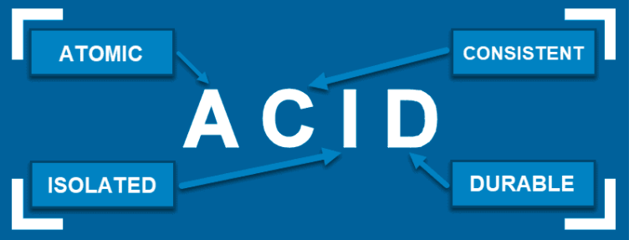
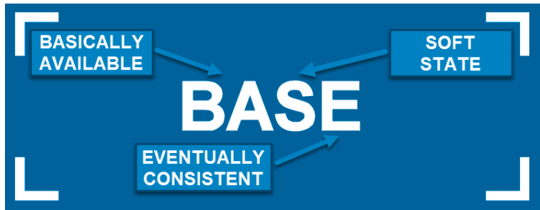
ACID vs. BASE
The tradeoff between ACID and BASE is a spectrum, not a binary choice.
Given their highly structured nature, ACID-compliant databases will be a better fit for those who require consistency, predictability, and reliability.
Those who consider growth to be among their priorities will likely want to choose the BASE model, because it enables easier scaling up and provides more flexibility. However, BASE also requires developers who will know how to deal with the limitations of the model.

Slide 104
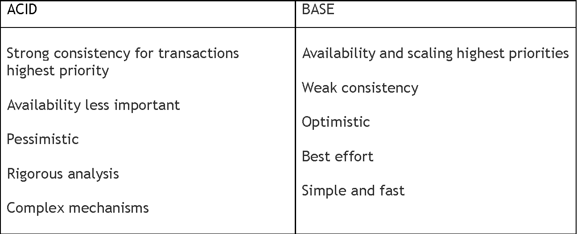
ACID vs BASE

Slide 105
NoSQL and map-reduce
The rise of aggregate-oriented databases is in large part due to the growth of clusters.
If you store lots of data on a cluster, processing that data efficiently means you have to think differently about how you organize your processing.
The map-reduce pattern provides a way to organize processing in such a way as to take advantage of multiple machines on a cluster while keeping as much processing and the data it needs together on the same machine.
Each NoSQL systems has its own implementation of the map-reduce framework.

Slide 106
Conclusions (1)
Limitations RDBMs:
Simple attributes
Impedance Mismatch
Not designed to work on clusters
Common characteristics of NoSQL databases:
Don’t use SQL.
Open-source projects.
Driven by the need to run on clusters.
Operate without a schema.
Aggregate-oriented models helps greatly when running queries on a cluster to minimize how many nodes we need to query when we are gathering data

Slide 107
Conclusions (2)
Categories of NoSQL systems:
Key-value systems (e.g., Riak).
Document systems (e.g., MongoDB and DynampDB).
Column-family systems (e.g., Cassandra and Bigtable).
Graph databases (e.g, Neo4J).
Modeling for data access: when modeling data aggregates, we need to consider how the data is going to be read as well as what are the side effects on data related to those aggregates.

Slide 108
Conclusions (3)
One of the biggest differences a centralized relational database to a cluster-oriented NoSQL database is in how you think about consistency.
CAP theorem: It is impossible for a web service to provide following three guarantees at the same time:
Consistency
Availability
Partition-tolerance
CAP theorem conclusion: in a distributed systems, can avoid network partitioning, and hence you have to trade off consistency versus availability.

Slide 109
Amazon DynamoDB
© 2019, Amazon Web Services, Inc. or its Affiliates. All rights reserved.
Notes:
Welcome to Module 8: Databases

Slide 110
Topics
Background: Managed services & JSON
Amazon DynamoDB key concepts
DynamoDB partitions and Data distribution
Indexes in with Amazon DynamoDB
Read/write throughput
Describe how Amazon DynamoDB keeps data consistent
Recognize when streaming and global tables are used
Develop with Amazon DynamoDB using the AWS SDK – Lab 11

Slide 111
Background: Managed services & JSON
Notes:
Part 2. Amazon DynamoDB key concepts

Slide 112




Unmanaged versus managed services
AWS solutions typically fall into one of two categories: unmanaged or managed.
Unmanaged:
Scaling, fault tolerance, and availability are managed by you.
Managed:
Scaling, fault tolerance, and availability are typically built in to the service.
Notes:
AWS solutions typically fall into one of two categories: unmanaged or managed.
Unmanaged services are typically provisioned in discrete portions as specified by the user. You must manage how the service responds to changes in load, errors, and situations where resources become unavailable. Say that you launch a web server on an Amazon Elastic Compute Cloud (Amazon EC2) instance. Because Amazon EC2 is an unmanaged solution, that web server will not scale to handle increased traffic load or replace unhealthy instances with healthy ones unless you specify that it use a scaling solution, such as AWS Automatic Scaling. The benefit to using an unmanaged service is that you have more fine-tuned control over how your solution handles changes in load, errors, and situations where resources become unavailable.
Managed services require the user to configure them. For example, you create an Amazon Simple Storage Service (Amazon S3) bucket and then set permissions for it. However, managed services typically require less configuration. Say that you have a static website that you host in a cloud-based storage solution, such as Amazon S3. The static website does not have a web server. However, because Amazon S3 is a managed solution, features such as scaling, fault-tolerance, and availability would be handled automatically and internally by Amazon S3.

Slide 113

Example on using managed services: From on-premises databases to Amazon RDS
Database in Amazon Elastic Compute Cloud (Amazon EC2)
Database in Amazon RDS
On-premises database
Application optimization
Scaling
High Availability
Database backups
Database software patches
Database software installs
Operation system patches
Operating system install
Server maintenance
Rack and stack servers
Power, HVAC, network
Application optimization
Scaling
High Availability
Database backups
Database software patches
Database software installs
Operation system patches
Operating system install
Server maintenance
Rack and stack servers
Power, HVAC, network
Application optimization
Scaling
High Availability
Database backups
Database software patches
Database software installs
Operation system patches
Operating system install
Server maintenance
Rack and stack servers
Power, HVAC, network
AWS
provides
AWS
provides
Notes:
What does the term managed services mean?
When your database is on premises, the database administrator is responsible for everything. Database administration tasks include optimizing applications and queries; setting up the hardware; patching the hardware; setting up networking and power; and managing heating, ventilation, and air conditioning (HVAC).
If you move to a database that runs on an Amazon Elastic Compute Cloud (Amazon EC2) instance, you no longer need to manage the underlying hardware or handle data center operations. However, you are still responsible for patching the OS and handling all software and backup operations.
If you set up your database on Amazon RDS, you reduce your administrative responsibilities. By moving to the cloud, you can automatically scale your database, enable high availability, manage backups, and perform patching. Thus, you can focus on what really matters most—optimizing your application.

Slide 114

Managed services responsibilities
You manage:
Application optimization
AWS manages:
OS installation and patches
Database software installation and patches
Database backups
High availability
Scaling
Power and racking and stacking servers
Server maintenance
Notes:
With Amazon managed services, you manage your application optimization. AWS manages installing and patching the operating system, installing and patching the database software, automatic backups, and high availability.
AWS also scales resources, manages power and servers, and performs maintenance.
Offloading these operations to the managed Amazon service reduces your operational workload and the costs that are associated with your relational database.

Slide 115
What is JSON?
JSON : JavaScript Object Notation:
Is a syntax for storing and transporting data that contains:
Key-value pairs
Arrays (lists) and other objects
Enables complex data structures to be exchanged a single document
Notes:
Some of the AWS services that are discussed later in this module—such as AWS CloudFormation—support JavaScript Object Notation (JSON) as a data format. To use AWS CloudFormation, it is important that you understand the JSON format. You should be able to understand the structure of a JSON document, and you might even want to author some AWS CloudFormation template sections in JSON. Therefore, in this section, you will be introduced to the essentials of JSON.
JSON is a syntax for storing and transporting data. It is a text-based format, so it is human-readable. JSON documents are easily written. They store key-value pairs and arrays of data. The data can be structured so that you can store very complex data structures in a single JSON document. The key use case for JSON is that it supports the simple exchange of complex data between computer systems.

Slide 116
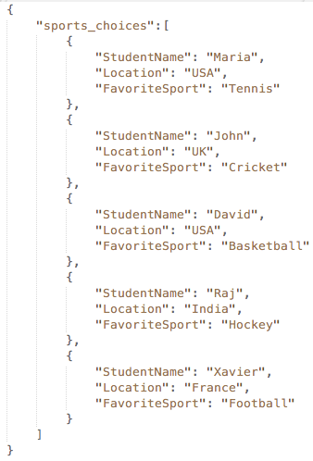
Representation of data
StudentName | Location | FavoriteSport
Maria | USA | Tennis
John | UK | Cricket
David | USA | Basketball
Raj | India | Hockey
Xavier | France | Football
Data in rows and columns
Data in JSON
Notes:
You commonly see data in a columnar format, such as in a table. However, to store table data in a way that is easy for machines to ingest, parse, and distribute, it must be stored in a non-graphical way.
JSON provides a way to store data objects in a human-readable text document. As you can see in the example, columnar data from a table—which consists of three columns and five rows—can be stored in JSON format.

Slide 117
Pros and cons of JSON
Advantages:
Lightweight (minimal syntax and mockup)—good for APIs.
Easy for humans to read and write.
Easy for machines to parse and generate.
Disadvantages:
Not tabular, so it is more difficult to read.
No native support for binary data (such as image files).
Notes:
Like any standard, JSON has both advantages and disadvantages.
One key advantage of JSON is that it is lightweight. JSON has only a few syntax rules that must be followed so that the JSON document is valid. It is also a good choice for use with APIs. In fact, JSON is a common data exchange format for modern RESTful APIs.
JSON is also easy for humans to read, and it is easy for machines to parse and generate.
However, JSON also has some disadvantages. Because the data is not tabular, it is more difficult to read. Also, it is more verbose, so you might have long files where many lines in the file consist of only an opening or closing curly brace ({}). Another disadvantage of JSON is that it does not have built-in support for storing multimedia formats (such as images) in JSON.

Slide 118

JSON building blocks: Objects
How would you describe this dessert?
Cake
Feeds 8 people
Chocolate
$20
Notes:
Consider how you would describe an object, such as the dessert shown here. What characteristics does it have? Four characteristics that describe this dessert are highlighted.

Slide 119
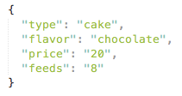
JSON building blocks: Objects
You can structure that information into a JSON object.
Key
Value
Notes:
Here, you see that the characteristics of the cake that were identified are now captured in a JSON object. The next slide discusses the structure of this JSON object.

Slide 120
JSON building blocks: Objects
JSON building blocks: Objects
Curly braces { } act as a container.
JSON uses universal data structures:
An object is an unordered set of key-value pairs
An object begins and ends with {}
Each key is followed by a :
Each key-value pair is separated by a ,
Notes:
JSON objects are enclosed in curly braces. JSON data structures must follow specific rules.
First, a JSON object consists of an unordered set of key-value pairs. Notice that a colon is used to separate the keys from the values, and all keys and values are enclosed in quotation marks. Key-value pairs within an object are separated by commas.
Notice that the last key-value pair does not have a comma after it.
In the example, the flavor key-value pair could come before the type key-value pair, and the object would still be considered valid by a program or person that receives this JSON object.
If you had another dessert and wanted to describe that dessert using the same keys, it might look something like this:
{
"type": "pie",
"flavor": "apple",
"price": "16",
"feeds": "6"
}
Notice that the same keys are used, but the values are different.

Slide 121
JSON building blocks: Arrays
What additional attributes could you use to describe this dessert?
Mint
Blueberries
Notes:
If you wanted to be more specific about this dessert, you could document additional characteristics. For example, it has both blueberries and mint as additional ingredients.

Slide 122
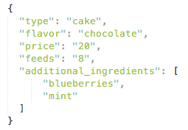
JSON building blocks: Arrays
You can put the additional ingredients information in an Array.
Notes:
Here you see that an additional_ingredients array has been added to the JSON object. Arrays are formatted differently than key-value pairs. The next slide discusses the format of a JSON array.

Slide 123
JSON building blocks: Arrays
JSON building blocks: Arrays
Square [ ] brackets hold arrays
An array is an ordered list of values
An array begins with a [ (left bracket) and ends with a ] (right bracket)
Values are separated by a , (comma)
Values can consist of multiple types
For example: string, number, object, array, Boolean
Notes:
To define an array in JSON, enclose it in square brackets.
An array in JSON is an ordered collection of values. Unlike the key-value pairs at the root of a JSON object, JSON arrays are ordered, so that you can parse them by index value. For example, if you want to pull mint from the example object, you would refer to objectName.additional_ingredients[1].
Array values can be one of these types: string, number, object, array, or Boolean. The example array has two values, both of which are strings (blueberries and mint). However, in longer and more complex JSON documents, you will often see arrays that contain other JSON objects or other JSON arrays.

Slide 124
Amazon DynamoDB key concepts
Notes:
Part 2. Amazon DynamoDB key concepts

Slide 125

What is Amazon DynamoDB?
Fast and flexible NoSQL database service for any scale
NoSQL database tables
Virtually unlimited storage
Items can have differing attributes
Low-latency queries
Scalable read/write throughput
Amazon DynamoDB
Notes:
DynamoDB is a fast and flexible NoSQL database service for all applications that need consistent, single-digit-millisecond latency at any scale.
Amazon manages all the underlying data infrastructure for this service and redundantly stores data across multiple facilities in a native US Region as part of the fault-tolerant architecture. With DynamoDB, you can create tables and items. You can add items to a table. The system automatically partitions your data and has table storage to meet workload requirements. There is no practical limit on the number of items that you can store in a table. For instance, some customers have production tables that contain billions of items.
One of the benefits of a NoSQL database is that items in the same table can have different attributes. This gives you the flexibility to add attributes as your application evolves. You can store newer format items side by side with older format items in the same table without needing to perform schema migrations.
As your application becomes more popular and as users continue to interact with it, your storage can grow with your application's needs. All the data in DynamoDB is stored on solid state drives (SSDs) and its simple query language enables consistent low-latency query performance. In addition to scaling storage, DynamoDB also enables you to provision the amount of read or write throughput that you need for your table. As the number of application users grows, DynamoDB tables can be scaled to handle the increased numbers of read/write requests with manual provisioning. Alternatively, you can enable automatic scaling so that DynamoDB monitors the load on the table and automatically increases or decreases the provisioned throughput.
Some additional key features include global tables that enable you to automatically replicate across your choice of AWS Regions, encryption at rest, and item Time-to-Live (TTL).

Slide 126
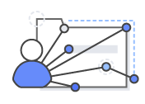



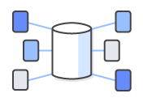
Amazon DynamoDB
Fine-grained access control
Fully managed
Amazon DynamoDB
Fast, consistent performance
Flexible
Notes:
Unstructured data can be stored in a non-relational NoSQL database, such as Amazon DynamoDB. Amazon DynamoDB is a fast and flexible non-relational database service for all applications that need consistent, single-digit millisecond latency at any scale. It is a fully managed cloud database and supports both document and key-value store models.
Amazon DynamoDB offers the following benefits:
Fully managed – DynamoDB is a fully managed, non-relational database service—you simply create a database table, set your target utilization for automatic scaling, and let the service handle the rest. You no longer need to worry about database management tasks, such as hardware or software provisioning, setup and configuration, software patching, operating a distributed database cluster, or partitioning data over multiple instances as you scale. DynamoDB also provides point-in-time recovery, backup, and restore for all your tables, helping you meet your corporate and regulatory archival requirements.
Fast, consistent performance – Average service-side latencies are typically single-digit milliseconds. As your data volumes grow and application performance demands increase, DynamoDB uses automatic partitioning and solid state drive (SSD) technologies to meet your throughput requirements and deliver low latencies at any scale.
Fine-grained access control – DynamoDB integrates with AWS Identity and Access Management (IAM) for fine-grained access control of users in your organization. You can assign unique security credentials to each user and control each user's access to services and resources.
Flexible – DynamoDB supports storing, querying, and updating documents. By using the AWS software development kit (SDK), you can write applications that store JavaScript Object Notation (JSON) documents directly into Amazon DynamoDB tables. This capability reduces the amount of new code that must be written to insert, update, and retrieve JSON documents. You can also perform powerful database operations, such as nested JSON queries, by using a few lines of code.

Slide 127
Amazon DynamoDB core components
The core DynamoDB components:
Table is a collection of data.
Items are a group of attributes that is uniquely identifiable among all the other items.
Attributes are a fundamental data element, something that does not need to be broken down any further.
DynamoDB supports two different kinds of primary keys:
Partition key: a simple primary key that is composed of one attribute
Partition and sort key: also known as the composite primary key, which is composed of two attributes.
Notes:
To learn more about how DynamoDB works, see:
Table item attributes

Slide 128
Basic components of DynamoDB
Primary key – A table has a primary key that uniquely identifies each item in the table. No two items can have the same key.
When compared to the components of a relational database table, items are analogous to rows and attributes are analogous to columns.
Table
Items
Attributes
Sort key
(Optional)
Primary key components
Partition key
(Required)
Notes:
The basic components of DynamoDB are:
Tables – DynamoDB stores data in tables. A table contains items with attributes.
Items – Each table contains zero or more items. An item is a group of attributes that is uniquely identifiable among all of the other items.
Attributes – Each item is composed of one or more attributes. An attribute is a fundamental data element, something that does not need to be broken down any further.
Primary key – A table has a primary key that uniquely identifies each item in the table. No two items can have the same key.
When compared to the components of a relational database table, items are analogous to rows and attributes are analogous to columns.

Slide 129

Items and attribute types
ItemNumber | Title | LeadActor | Price | InCirculation
12 | “My Favorite Video" | “James Smith" | 5.00 | true
Key-value item
{
"person_id" : 123,
"last_name" : “Doe",
"first_name" : "John",
"next_anniversary" :
{
"year" : 2018,
"month" : 5,
"day" : 30
},
"children" :
[“Dick", “Harry", “Jane”, “Mary" ]
}
JSON
String
Boolean
Number
Document item
Map
List
Notes:
Unlike a relational database, DynamoDB is not constrained by a pre-defined schema. An item can have any number of attributes with different value types. Each attribute has a name and a value. An attribute value can be one of the following types:
Scalar types – Number, String, Binary, Boolean, and Null
Multi-valued types – String Set, Number Set, and Binary Set
Document types – List and Map
The size of an item is the sum of the lengths of its attribute names and values. An item can be a maximum of 400 KB in size.

Slide 130
Types of primary keys
Simple Primary Key (partition key only)
Composite Primary Key (partition key and sort key)
SensorId (Partition Key) | Latitude | Longitude
SensorA | 40.712784 | -74.005941
SensorB | 35.689488 | 139.691706
SensorId (Partition Key) | Time (Sort Key) | Value
SensorA | 2018-01-03T10:15:30 | 30
SensorA | 2018-01-04T10:19:30 | 35
SensorB | 2018-03-04T11:21:20 | 28
SensorLocation Table
SensorReadings Table
Unlike a relational database, DynamoDB is not constrained by a pre-defined schema. An item can have any number of attributes with different value types.
Notes:
DynamoDB supports two types of primary keys:
Simple primary key – The simple primary key is composed of one attribute known as the partition key. DynamoDB builds an unordered index on this primary key attribute. Each item in the table is uniquely identified by its partition key value.
In the SensorLocation table, the primary key is a partition key because it consists of a single attribute SensorId, which is the partition key. Each item in the table is uniquely identified by its partition key value (SensorA and SensorB). Also, each sensor has exactly one location, which is expressed in terms of latitude and longitude.
Composite primary key – The composite primary key is composed of two attributes: the partition key and the sort key. DynamoDB builds an unordered index on the partition key attribute and a sorted index on the sort key attribute. In a table that has a partition key and a sort key, it's possible for two items to have the same partition key value. However, those two items must have different sort key values.
In the SensorReadings table, the primary key is a partition and sort primary key because it is composed of the SensorId attribute (the partition key) and the Time attribute (the sort key). For each SensorId, there might be multiple items corresponding to sensor readings at different times. The combination of SensorId and Time uniquely identifies items in the table. This design enables you to query the table for all readings related to a particular sensor.
Remember that DynamoDB can be used as a key-value store and document store. In the examples shown, the primary key value (partition key and sort key if present) is the key, and the remaining attributes constitute the value that corresponds to the key.

Slide 131
Partitions and data distribution
Notes:
Part 3: Partitions and data distribution

Slide 132
Partitions
DynamoDB stores data in partitions.
A partition is an allocation of storage for a table, backed by solid state drives (SSDs), and automatically replicated across multiple Availability Zones within an AWS Region.
Partition management is handled entirely by DynamoDB.
Partition key: A
Partition key: B
Partition key: D
Partition key: C
Table data is stored in partitions based on the partition key.

Slide 133
Partitions (continued)
Each item in the table is uniquely identified by the combination of its partition key and sort key values.
If your table has a simple primary key (partition key only), DynamoDB stores and retrieves each item based on its partition key value.
The partition key of an item is also known as its hash attribute.
If a table has a composite primary key (partition key and sort key), then DynamoDB will store all of the items with the same partition key value physically close together and order them by sort key value in the partition.
The sort key of an item is also known as its range attribute.
DynamoDB builds an unordered index on the partition key attribute and a sorted index on the sort key attribute.

Slide 134

Amazon DynamoDB data model
Attributes store data elements.
Table = Collection of items
Data partitioned by the partition key
User
ID
Order
ID
Partition Key: A
Partition Key: B
Partition Key: D
Partition Key: C
Item = Collection
of attributes
Partition key
Sort key

Slide 135
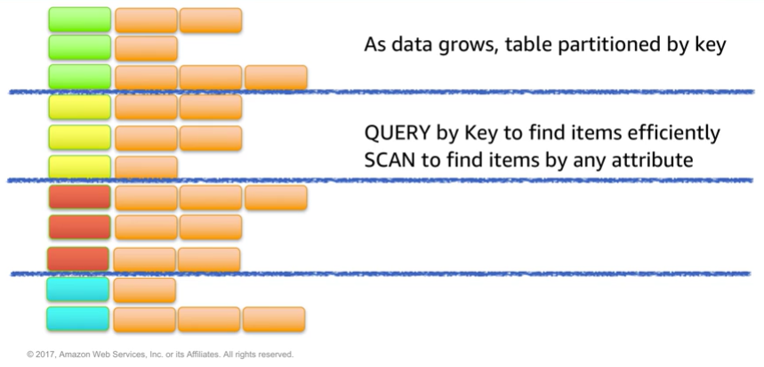
Partitioning
Notes:
As data grows, table data is partitioned and indexed by the primary key.
You can retrieve data from a DynamoDB table in two different ways:
In the first method, the query operation takes advantage of partitioning to effectively locate items by using the primary key.
The second method is via a scan, which enables you to locate items in the table by matching conditions on non-key attributes. The second method gives you the flexibility to locate items by other attributes. However, the operation is less efficient because DynamoDB will scan through all the items in the table to find the ones that match your criteria.

Slide 136
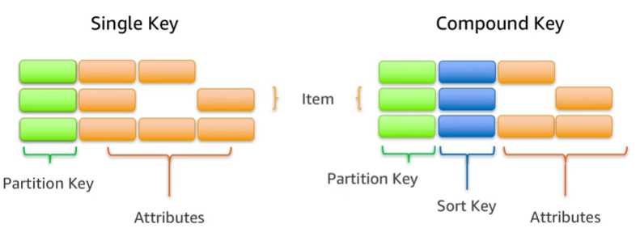
Items in a table must have a key

Slide 137
Designing DynamoDB Tables
To take full advantage of query operations and DynamoDB, it's important to think about the key that you use to uniquely identify items in the DynamoDB table. You can set up a simple primary key that is based on a single attribute of the data values with a uniform distribution, such as the Globally Unique Identifier (GUID) or other random identifiers.
For example, if you wanted to model a table with products, you could use some attributes like the product ID.
Alternatively, you can specify a compound key, which is composed of a partition key and a secondary key. In this example, if you had a table with books, you might use the combination of author and title to uniquely identify table items.
This method could be useful if you expect to frequently look at books by author because you could then use query.

Slide 138
Uniform workloads
Distribute read and write operations evenly across partition keys to maximize throughput.
Read or write operations are limited to a small number of partitions. The range of partition keys is limited.
Read or write operations are distributed over more partitions. Partition keys contain a calculated suffix.
124
201
204
205
289
297
303
308
313
124.7
201.3
204.6
205.7
289.19
297.18
303.6
308.11
313.7
Hot Partition
Notes:
The partition key determines the distribution of data across the partitions where data is stored. The total throughput that is provisioned for a table is divided equally across partitions.
When you make a large number of consecutive reads or consecutive writes to a narrow range of partition keys, the same partitions are accessed repeatedly (hot partitions). The throughput allocated to remaining partitions remains unused.
To achieve maximum read/write throughput, implement your read/write operations as follows:
Choose the partition key carefully to avoid hot spots.
Consider concatenating a random number or a calculated value to the partition key when data is written so that you can ensure the distribution of partition keys. For example, you might concatenate the sum of the ASCII values of each character in the partition key.
Distribute reads and writes across multiple partitions.

Slide 139
Partitioning with simple primary key: Example
{
"AnimalType": "Dog",
<other attributes>
}
DynamoDB hash function
{
"AnimalType": "Turtle",
<other attributes>
}
{
"AnimalType": "Dog",
<other attributes>
}
Hash function
Uses partition key value as input. Output determines what partition to put the data in
{
"AnimalType": “Lizard",
<other attributes>
}
Partition
Partition
Pets table
Notes:
In this example, the Pets table has a simple key (partition key only) and spans multiple partitions. DynamoDB calculates the hash value of the partition key to determine which partition should contain the item, which in this case, is based on the hash value of the string Dog. Note that the items are not stored in sorted order.

Slide 140
Partitioning with composite primary key: Example
{
"AnimalType": "Dog",
"Name": "Rover",
<other attributes>
}
{
"AnimalType": "Turtle",
"Name": "Ernest",
<other attributes>
}
{
"AnimalType": "Dog",
"Name": "Fido",
<other attributes>
}
{
"AnimalType": “Lizard",
"Name": “Quincy",
<other attributes>
}
{
"AnimalType": "Dog",
"Name": "Rover",
<other attributes>
}
DynamoDB hash function
Partition
{
"AnimalType": "Dog",
"Name": "Spot",
<other attributes>
}
DynamoDB stores the new item among the others with the same partition key in ascending order by sort key.
Pets table
Partition
Notes:
Suppose that the Pets table has a composite primary key consisting of AnimalType (partition key) and Name (sort key). DynamoDB again calculates the hash value of the partition key to determine which partition should contain the item. In that partition, there are several items with the same partition key value, so DynamoDB stores the new item among the others with the same partition key, in ascending order by sort key. In this example, DynamoDB writes an item with a partition key value of Dog and a sort key value of Fido in ascending order.

Slide 141
Retrieving Data from a DynamoDB table
You can retrieve data from a DynamoDB table in two different ways:
Query: the query operation takes advantage of partitioning to effectively locate items by using the primary key.
Scan: enables you to locate items in the table by matching conditions on non-key attributes.
This gives you the flexibility to locate items by other attributes.
However, the operation is less efficient because DynamoDB will scan through all the items in the table to find the ones that match your criteria.

Slide 142


One-to-many tables
Use one-to-many tables instead of a large number of attributes.
Complex Forum Thread Table
Simple Forum Thread Table
{
"thread_id" : 123,
"subject" : "How do I cook potatoes?",
"replies" :
["Boil…", "Bake…", "Roast…", "Fry…", "Mash…"]
}
{
"thread_id" : 123,
"subject" : "How do I cook potatoes?"
}
{
"thread_id" : 123,
"reply_id" : "abc"
"reply" : "Boil for 10 minutes"
}
{
"thread_id" : 123,
"reply_id" : "def"
"reply" : "Bake for 45 minutes"
}
ReplyTable
Notes:
If your table has items that store a large number of values in an attribute that is of a set type, such as string set or number set, consider removing the set attribute from the table and splitting it into separate items in another table.
For example, consider a table that stores threads in a forum. If the table stores replies for each thread as a string set in each thread item, an individual thread item can become large. The item size is likely to exceed the maximum item size in Dynamo DB. Throughput will be reduced because you will unnecessarily fetch large amounts of data, even if you only need minimum information such as the thread subject.
Instead, you can remove the replies from the forum thread table. Create a separate table to store the replies as individual items.

Slide 143
Varied access patterns
Store frequently accessed small attributes in a separate table.
Company Table
{
“companyName" : “Example",
“stockPrice”: 285,
“aboutCompany”: “Example company builds ships”,
“missionStatement”: “Our mission is to build the best ships.”,
“logoHighResolution”: “example.png”
}
Company Stock Table
{
“companyName" : “Example",
“stockPrice”: 285
}
Company Table
{
“companyName " : “Example",
“aboutCompany”: “Example company builds ships”,
“missionStatement”: Our mission is to build the best ships.”,
“logoHighResolution”: “example.png”
}
Notes:
If you frequently access large items in a table but do not use the large attribute values, consider storing frequently accessed smaller attributes in a separate table.
For example, consider the Company table. It has fairly large attributes, such as company information, mission statement, and logo. These attributes are fairly static and rarely accessed. To improve throughput, consider splitting the frequently changing and frequently read stock price attribute to a separate table.

Slide 144
Secondary indexes Amazon DynamoDB provides fast access to items in a table by specifying primary key values. However, many applications might benefit from having one or more secondary (or alternate) keys available, which allows for efficient access to data with attributes other than the primary key. To address this, you can create one or more secondary indexes on a table
Notes:
.

Slide 145
Secondary indexes
Enable you to query data based on non-primary key attributes.
A secondary index defines an alternate key.
Contain:
Alternate key attributes.
Primary key attributes.
Optional subset of other attributes from the base table (projected attributes).
Can be one of two types:
Global secondary index (GSI).
Local secondary index (LSI).
Notes:
A secondary index enables you to perform queries on attributes that are not part of the table’s primary key. A secondary index lets you query the data in the table by using an alternate key, in addition to queries against the primary key.
In addition to the alternate key attributes and primary key attributes (partition key and sort key), a secondary index contains a subset of the other table attributes. When you create an index, you specify which attributes will be copied, or projected, from the base table to the index. At a minimum, DynamoDB projects the key attributes from the base table into the index.

Slide 146
Types of Secondary Indexes
DynamoDB supports two types of secondary indexes:
Global secondary index (GSI) – An index with a partition key and a sort key, both of which can be different from those on the base table. A global secondary index is considered global because queries on the index can span all of the data in the base table, across all partitions. A global secondary index has no size limitations and has its own provisioned throughput settings for read and write activity that are separate from those of the table.
Local secondary index (LSI)– An index that has the same partition key as the base table, but a different sort key. A local secondary index is local in the sense that every partition of a local secondary index is scoped to a base table partition that has the same partition key value. As a result, the total size of indexed items for any one partition key value can't exceed 10 GB. Also, a local secondary index shares provisioned throughput settings for read and write activity with the table it is indexing.
Each table in DynamoDB has a limit of 20 global secondary indexes (default limit) and 5 local secondary indexes per table.
Notes:
For more information on secondary indexes, see https://docs.aws.amazon.com/amazondynamodb/latest/developerguide/SecondaryIndexes.html.

Slide 147
Global secondary index example
Music Table
GenreAlbumTitle Secondary Index
{
"Artist": "No One You Know",
"SongTitle": "My Dog Spot",
"AlbumTitle": "Hey Now",
"Price": 1.98,
"Genre": "Country",
"CriticRating": 8.4
}
{
"Artist": "No One You Know",
"SongTitle": "Somewhere Down the Road",
"AlbumTitle": "Somewhat Famous",
"Genre": "Country",
"CriticRating": 8.4
"Year": 1984
}
{
"Artist": "The Acme Band",
"SongTitle": "Look Out, World",
"AlbumTitle": "The Buck Starts Here",
"Price": 0.99
"Genre": "Rock"
}
zzz
{
"Genre": "Country",
"AlbumTitle": "Hey Now",
"Artist": "No One You Know",
"SongTitle": "My Dog Spot",
}
{
"Genre": "Country",
"AlbumTitle": "Somewhat Famous",
"Artist": "No One You Know",
"SongTitle": "Somewhere Down the Road",
}
{
"Genre": "Rock"
"AlbumTitle": "The Buck Starts Here",
"Artist": "The Acme Band",
"SongTitle": "Look Out, World",
}
Different partition key and sort key than the table.
The combination of Genre and Album Title might not be unique.
Notes:
Here is an example of when you would use a global secondary index. Say you have a Music table. You can query data items by Artist (partition key) or by Artist and SongTitle (partition key and sort key). What if you also wanted to query the data by Genre and AlbumTitle? You cannot do this query with the Music table. To do this, you create a global secondary index on Genre and AlbumTitle from the base Music table, and then query the index in much the same way that you would query the Music table. In the index, Genre is the partition key and AlbumTitle is the sort key. Note that the combination of Genre and Album Title might not be unique. Multiple albums can belong to one genre.

Slide 148
Local secondary index example
Music Table
ArtistAlbumTitle Local Secondary Index
{
“Artist": “No One You Know",
"SongTitle": "My Dog Spot",
"AlbumTitle": "Hey Now",
"Price": 1.98,
"Genre": "Country",
"CriticRating": 8.4
}
{
"Artist": "No One You Know",
"SongTitle": "Somewhere Down the Road",
"AlbumTitle": "Somewhat Famous",
"Genre": "Country",
"CriticRating": 8.4
"Year": 1984
}
{
"Artist": "The Acme Band",
"SongTitle": "Look Out, World",
"AlbumTitle": "The Buck Starts Here",
"Price": 0.99
"Genre": "Rock"
}
{
“Artist": “No One You Know",
"AlbumTitle": "Hey Now",
"SongTitle": "My Dog Spot",
“Genre": “Country",
}
{
“Artist": “No One You Know",
"AlbumTitle": "Somewhat Famous",
"SongTitle": "Somewhere Down the Road",
“Genre": “Country",
}
{
“Artist": “The Acme Band"
"AlbumTitle": "The Buck Starts Here",
"SongTitle": "Look Out, World",
“Genre": “Rock",
}
Same partition key as the table but different sort key.
Notes:
Now, say that you want to query by Artist and by AlbumTitle. In this case, you would create a local secondary index (called ArtistAlbumTitle) from the base Music table. The local secondary index has the same partition key as the base table (Artist) but a different sort key (AlbumTitle).
For a local secondary index, the partition key is the same as the table’s partition key. The sort key can be any scalar attribute.

Slide 149
Read/write throughput
Notes:
Part 5: Read/write throughput

Slide 150
Read consistency
DynamoDB maintains multiple copies of data for durability.
All copies of your data are usually consistent within a second after a write operation.
Eventually consistent read might return slightly stale data if a read operation is performed immediately after a write operation.
Use case: blog posts
Strongly consistent read returns most up-to-date data.
Use cases: score boards, booking systems, financial algorithms
You can specify the desired consistency level when reading data.
Notes:
DynamoDB automatically replicates your data across multiple Availability Zones in an AWS Region, which provides built-in high availability and data durability. All copies of your data are usually consistent within a second after a write operation.
DynamoDB supports eventually consistent and strongly consistent reads.
Eventually Consistent Reads – When you read data from a DynamoDB table, the response might not reflect the results of a recently completed write operation. The response might include some stale data. If you repeat your read request after a short time, the response should return the latest data.
Strongly Consistent Reads – When you request a strongly consistent read, DynamoDB returns a response with the most up-to-date data, which reflects the updates from all prior write operations that were successful. A strongly consistent read might not be available if there is a network delay or outage. Consistent reads are not supported on global secondary indexes.
You can specify the desired consistency level when reading data.
For more information on read consistency, see the AWS Documentation: https://docs.aws.amazon.com/amazondynamodb/latest/developerguide/HowItWorks.ReadConsistency.html

Slide 151
Transactions
Simplify the developer experience of making coordinated, all-or-nothing changes (inserts, deletes, or updates) to multiple items both within and across tables.
Provide atomicity, consistency, isolation, and durability (ACID), enabling you to maintain data correctness in your applications easily.
Use cases
Processing financial transactions
Fulfilling and managing orders
Building multiplayer game engines
Coordinating actions across distributed components and services
Notes:
Amazon DynamoDB transactions simplify the developer experience of making coordinated, all-or-nothing changes to multiple items both within and across tables. Transactions provide atomicity, consistency, isolation, and durability (ACID) in DynamoDB, and they enable you to maintain data correctness in your applications.
Many use cases are easier and faster to implement using transactions, for example:
Processing financial transactions
Fulfilling and managing orders
Building multiplayer game engines
Coordinating actions across distributed components and services
For more information about Amazon DynamoDB Transactions, see the Developer Guide: https://docs.aws.amazon.com/amazondynamodb/latest/developerguide/transactions.html

Slide 152
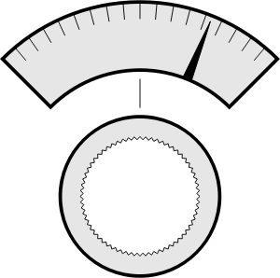
Provisioned read/write throughput
Provisioned throughput is the maximum amount of capacity that an application can consume from a table or index.
If your application exceeds your provisioned throughput capacity on a table or index, it is subject to request throttling.
Throughput = maximum amount of capacity that an application can consume from a table or index
Divided evenly among partitions
Read capacity unit (RCU)
Number of strongly consistent reads per second of items that are up to 4 KB in size
Eventually consistent reads use half of the provisioned read capacity
Write capacity unit (WCU)
Number of 1 KB writes per second
RCU
WCU
Notes:
Amazon DynamoDB supports both provisioned and on-demand throughput. Provisioned throughput is the maximum amount of capacity that an application can consume from a table or index. If your application exceeds your provisioned throughput capacity on a table or index, it is subject to request throttling.
DynamoDB divides throughput evenly among partitions. The throughput per partition is the total provisioned throughput divided by the number of partitions.
With provisioned throughput, you specify the throughput capacity in terms of read capacity units (RCU) and write capacity units (WCU):
A read capacity unit is the number of strongly consistent reads per second of items that are up to 4 KB in size. If you perform eventually consistent reads, you use half of the read capacity units that are provisioned. In other words, for eventually consistent reads, one read capacity unit is two reads per second for items that are up to 4 KB.
A write capacity unit is the number of 1 KB writes per second.

Slide 153
On-demand read/write throughput
Pay-per-request pricing for read and write requests
DynamoDB adapts rapidly to accommodate the workload
Request rate limited by throughput default table limits
Create or update a table to use on-demand mode
Use cases
You create new tables with unknown workloads.
You have unpredictable application traffic.
You prefer the ease of paying for only what you use.
Notes:
When you choose Amazon DynamoDB on-demand, DynamoDB instantly accommodates your workloads as they ramp up or down to any previously reached traffic level. If a workload’s traffic level reaches a new peak, DynamoDB adapts rapidly to accommodate the workload. Tables that use on-demand mode deliver the same single-digit millisecond latency, service-level agreement (SLA) commitment, and security that DynamoDB already offers. You can choose on-demand for both new and existing tables, and you can continue using the existing DynamoDB application programming interfaces (APIs) without changing code. DynamoDB on-demand offers pay-per-request pricing for read and write requests so that you pay only for what you use.
On-demand mode is a good option if any of the following situations are true:
You create new tables with unknown workloads.
You have unpredictable application traffic.
You prefer the ease of paying for only what you use.
For more information about Amazon DynamoDB on-demand and provisioned modes, see Read/Write Capacity Mode: https://docs.aws.amazon.com/amazondynamodb/latest/developerguide/HowItWorks.ReadWriteCapacityMode.html

Slide 154
Activity: Calculating RCU
Say that you need to read 20 items that are 11 KB in size every second, with eventual consistency.
How many RCUs must you provision?
1 RCU = 1 strongly consistent , or 2 eventually consistent, reads per second for items up to 4 KB in size
RCU
Notes:
Say that you need to read 20 items that are 11 KB in size every second, with eventual consistency. How many RCUs do you need?

Slide 155
Calculating RCU: Answer
Answer: 30 RCU
Round 11 KB up to the next multiple of 4: 12
Divide by 4 KB per RCU: 3
Multiply by items read per second: 60
Divide by 2 for eventual consistency: 30
RCU
Notes:
Answer: You need 30 RCU.
Compute as follows:
Round 11 KB up to the next multiple of 4: 12
Divide by 4 KB per RCU: 3
Multiply by items read per second: 60
Divide by 2 for eventual consistency: 30

Slide 156
Activity: Calculating WCU
Say that you need to write 120 items that are 7 KB in size every minute.
How many WCUs must you provision?
1 WCU = 1 write per second, for items up to 1 KB in size
WCU
Notes:
Say that you need to write 120 items that are 7 KB in size every minute. How many WCUs do you need?

Slide 157
Calculating WCU: Answer
Answer: 14 WCU
WCU required to write each 7 KB item: 7
Number of items per second: 2 (120 per minute then 120/60 = 2 per second)
Multiply WCU per item by items per second: 14
WCU
Notes:
Answer: You need 14 WCU.
Compute as follows:
WCU required to write each 7 KB item: 7
Number of items per second: 2
Multiply WCU per item by items per second: 14

Slide 158
Global tables
Notes:
Part 6: Streams and global tables

Slide 159


Amazon DynamoDB global tables
Global table
Replica
us-west-2
Replica
us-east-1
Replica
eu-central-1
The DynamoDB global tables feature provides high availability and scalability across Regions.
A global table is a collection of one or more DynamoDB tables, which must all be owned by a single AWS account.
The tables in the collection are also known as replica tables. A replica table (or replica, for short) is a single DynamoDB table that functions as a part of a global table. Each replica stores the same set of data items.
When you create a global table, you specify the AWS Regions where you want the table to be available. DynamoDB performs all of the necessary tasks to create identical tables in these Regions, and also propagates ongoing data changes to all of them.
DynamoDB global tables are ideal for massively scaled applications, with globally dispersed users.
Notes:
DynamoDB global tables are ideal for massively scaled applications, with globally dispersed users. In such an environment, users expect very fast application performance, which they obtain by accessing the replica that is closest to them. In addition, if one of the AWS Regions were to become temporarily unavailable, users could still access the same data in the other Regions.

Slide 160
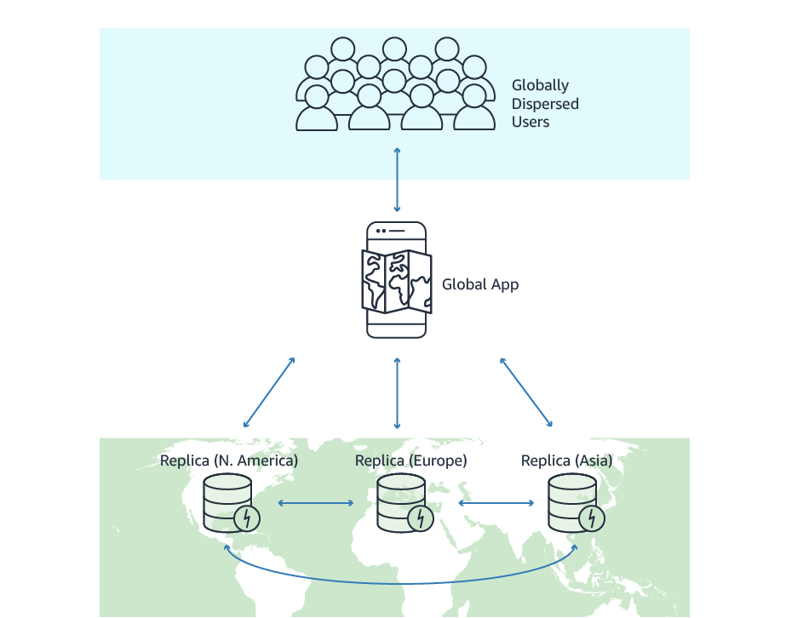
Global tables
A DynmoDB table is replicated across multiple Availability Zones in an AWS Region, which provides built-in high availability and data durability.
You can use global tables to keep DynamoDB tables in sync across AWS Regions.
Global tables is a solution for deploying a multi-Region, multi-active database without having to build and maintain your own replication solution.
Specify the AWS Regions where you want the table to be available.
Notes:
DynamoDB automatically spreads the data and traffic for your tables over a sufficient number of servers to handle your throughput and storage requirements, while maintaining consistent and fast performance. All of your data is stored on solid state disks (SSDs) and automatically replicated across multiple Availability Zones in an AWS Region, which provides built-in high availability and data durability. You can use global tables to keep DynamoDB tables in sync across AWS Regions.
Global tables provide a fully managed solution for deploying a multi-Region, multi-active database, without having to build and maintain your own replication solution. When you create a global table, you specify the AWS Regions where you want the table to be available. DynamoDB performs all of the necessary tasks to create identical tables in these Regions, and to propagate ongoing data changes to all of them.
To illustrate one use case for a global table, suppose that you have a large customer base spread across three geographic areas—North America, Europe, and Asia. Customers need to update their profile information while using your application. To address these requirements, you could create three identical DynamoDB tables named CustomerProfiles in three different AWS Regions. These three tables would be entirely separate from each other, and changes to the data in one table would not be reflected in the other tables. Without a managed replication solution, you could write code to replicate data changes among these tables; however, this would be a time-consuming and labor-intensive effort.
Instead of writing your own code, you could create a global table consisting of your three Region-specific CustomerProfiles tables. DynamoDB would then automatically replicate data changes among those tables, so that changes to CustomerProfiles data in one Region would be seamlessly propagated to the other Regions. In addition, if one of the AWS Regions were to become temporarily unavailable, your customers could still access the same CustomerProfiles data in the other Regions.

Slide 161
Global tables: Data replication
2
… are recorded in a stream…
3
… and propagated to other replicas.
1
Changes made in one replica…
DynamoDB stream
User | noteID | Note
AAA | 123A | Buy coffee
AAA | 45B | Buy milk
User | noteID | Note
AAA | 123A | Buy coffee
AAA | 45B | Buy milk
Replica: eu-central-1
User | noteID | Note
AAA | 123A | Buy coffee
AAA | 45B | Buy milk
Replica: us-east-1
Replica: us-west-2
Notes:
A global table is a collection of one or more DynamoDB tables called replica tables. A replica table (or replica, for short) is a single DynamoDB table that functions as a part of a global table. Each replica stores the same set of data items. Any given global table can only have one replica table per Region, and every replica has the same table name and the same primary key schema.
Global tables use DynamoDB Streams to propagate changes between replicas. Any changes that are made to any item in any replica table will be recorded in a stream and replicated to all of the other replicas within the same global table. In a global table, a newly written item is usually propagated to all replica tables within seconds. With a global table, each replica table stores the same set of data items. DynamoDB does not support partial replication of only some of the items.

Slide 162

Global tables: Concurrent updates
Write at 11:21:03 AM
Last write wins
Color = “Red”
Replica 1
Eventual consistency
Write at 11:21:04 AM
Color = “Green”
Color = “Green”
Replica 2
DynamoDB global tables use a “last writer wins” reconciliation between concurrent updates, where DynamoDB makes a best effort to determine the last writer.
Notes:
Conflicts can arise if applications update the same item in different Regions at about the same time. To achieve eventual consistency, DynamoDB global tables use a “last writer wins” reconciliation between concurrent updates, where DynamoDB makes a best effort to determine the last writer. With this conflict resolution mechanism, all of the replicas will agree on the latest update and converge toward a state in which they all have identical data.

Slide 163

Global tables: Read consistency
Region
Region
Strongly consistent
Eventually consistent
us-east-1
us-west-2

Slide 164
Global tables: Read consistency (continued)
An application can read and write data to any replica table.
If your application only uses eventually consistent reads, and only issues reads against one AWS Region, then it will work without any modification.
However, if your application requires strongly consistent reads, then it must perform all of its strongly consistent reads and writes in the same Region.
DynamoDB does not support strongly consistent reads across AWS Regions.

Slide 165
If you write to one Region and read from another Region, the read response might include stale data that doesn't reflect the results of recently completed writes in the other Region. Strongly consistent reads require using a replica in the same Region where the client is running.

Slide 166
Transactions
Transactions are enabled for all single-Region DynamoDB tables and are disabled on global tables by default.
You can choose to enable transactions on global tables by request, but replication across Regions is asynchronous and eventually consistent.
You might observe partially completed transactions during replication to other Regions.
Additionally, simultaneous writes to the same item in different Regions are not enabled.

Slide 167
Basic operations for Amazon DynamoDB tables Lab 11

Slide 168
Amazon DynamoDB API operations
Control operations – Create and manage DynamoDB tables.
E.g., CreateTable
Data operations – Create, read, update, and delete (CRUD) actions on data in a table.
E.g., Write operations: PutItem, UpdateItem, DeleteItem,
E.g., Read operations: GetItem, Query, Scan
Batch operations – Read and write batches of items in a DynamoDB table
Transaction operations – Make coordinated, all-or-nothing changes to multiple items both within and across tables

Slide 169
Creating a table
table = dynamodb.create_table(
TableName = 'users',
KeySchema = [
{
'AttributeName': 'username',
'KeyType': 'HASH'
},
{
'AttributeName': 'last_name',
'KeyType': 'RANGE'
}
],
AttributeDefinitions = [
{
'AttributeName': 'username',
'AttributeType': 'S'
},
{
'AttributeName': 'last_name',
'AttributeType': 'S'
}
],
ProvisionedThroughput = {
'ReadCapacityUnits': 5,
'WriteCapacityUnits': 5
}
)
Create_table: Creates a new table.
TableName is the name of the table to create.
KeySchema specifies the attributes that make up the primary key for the table.
users Table
username (Partition Key) | last_name (Sort Key)
AttributeDefinitions is an array of attributes that describes the key schema for the table.
RCU
5
WCU
5
ProvisionedThroughput represents the provisioned throughput settings for the table.
5
Notes:
CreateTable is an asynchronous operation that creates a new table. On receiving a CreateTable request, DynamoDB immediately returns a response with a TableStatus of CREATING. After the table is created, DynamoDB sets the TableStatus to ACTIVE. You can perform read and write operations only on an ACTIVE table. You can optionally define secondary indexes on the new table as part of the CreateTable operation.
This example shows how to create a table using Boto 3 (the AWS SDK for Python). The invocation of the create_table method creates a table named users with a partition-and-sort primary key that is composed of the attributes named username and last_name (which have hash and range key types, respectively). The provisioned throughput for the table is 5 RCU and 5 WCU.
For more information on the CreateTable operation and the parameters it takes, see the AWS Documentation: https://docs.aws.amazon.com/amazondynamodb/latest/APIReference/API_CreateTable.html

Slide 170
Creating an item
users Table Before
Put_item: Creates a new item or replaces (overwrites) an existing item.
username (Partition key) | last_name (Sort key)
table.put_item(
Item = {
'username': 'janedoe',
'first_name': 'Jane',
'last_name': 'Doe',
'age': 25,
'account_type': 'standard_user'
}
)
Item is a map of attribute name-value pairs, one for each attribute. Only the primary key attributes are required. You can optionally provide other attribute name-value pairs for the item.
username (Partition key) | last_name (Sort key) | first_name | Age | account_type
janedoe | Doe | Jane | 25 | standard_user
users Table After
Notes:
The PutItem operation creates a new item or replaces an old item with a new item. If an existing item in the specified table has the same primary key as the new item, the new item completely replaces the existing item. You can perform a conditional PUT operation (add a new item if an item with the specified primary key doesn't exist), or you can replace an existing item if it has certain attribute values. You can return the item's attribute values in the same operation by using the ReturnValues parameter.
Continuing with the Python example, after the users table has been created and assigned to the table variable, the put_item method is invoked to add a new item to the table.
For more information on the PutItem operation and the parameters it takes, see the AWS Documentation: https://docs.aws.amazon.com/amazondynamodb/latest/APIReference/API_PutItem.html

Slide 171
Updating an item
Update_Item: Edits an existing item's attributes, or adds a new item to the table if it does not already exist.
username (Partition key) | last_name (Sort key) | first_name | Age | account_type
janedoe | Doe | Jane | 25 | standard_user
users Table Before
table.update_item(
Key = {
'username': 'janedoe',
'last_name': 'Doe'
},
UpdateExpression = 'SET age = :val1',
ExpressionAttributeValues = {
':val1': 26
}
)
Key is the primary key of the item to be updated.
UpdateExpression defines one or more attributes to be updated.
ExpressionAttributeValues is one or more values that can be substituted in an expression.
username (Partition Key) | last_name (Sort key) | first_name | Age | account_type
janedoe | Doe | Jane | 26 | standard_user
users Table After
Notes:
The UpdateItem operation allows you to update an existing item's attributes, or add a new item to the table if it does not already exist. You add, set, or remove attribute values. You can also perform a conditional update on an existing item (for example, replace an existing name-value pair if it has certain expected attribute values). Additionally, you can return the item's attribute values, from either before or after the update, by using the ReturnValues parameter.
In this Python example, the update_item method is used to modify the age attribute of an item in the users table.
For more information on the UpdateItem operation and the parameters it takes, see the AWS Documentation: https://docs.aws.amazon.com/amazondynamodb/latest/APIReference/API_UpdateItem.html

Slide 172
Deleting an item
Delete_Item: Deletes a single item in a table
by primary key.
users Table Before
username (Partition key) | last_name (Sort key) | first_name | Age | account_type
janedoe | Doe | Jane | 26 | standard_user
table.delete_item(
Key = {
'username': 'janedoe',
'last_name': 'Doe'
}
)
Key represents the primary key of the item to delete.
users Table After
username (Partition key) | last_name (Sort key)
Notes:
The DeleteItem operation allows you to delete an item in a table by using its primary key. You can perform a conditional delete operation that deletes the item if it has an expected attribute value. In addition to deleting an item, you can also return the item's attribute values by using the ReturnValues parameter.
In this Python example, the delete_item method is used to delete an item from the users table.
For more information on the DeleteItem operation and the parameters it takes, see the AWS Documentation: https://docs.aws.amazon.com/amazondynamodb/latest/APIReference/API_DeleteItem.html

Slide 173
Condition expressions
For the PutItem, UpdateItem and DeleteItem operations, you can specify a condition expression to determine which items should be modified. If the condition expression evaluates to true, the operation succeeds; otherwise, the operation fails.
AccountStatus Table
userId (primary key) | lastFailedLoginTime | accountLocked
1 | 2018-06-06T19:20+01:00 | Y
UpdateItem Operation
Primary key: userId = 1
Set: accountLocked = N
ConditionExpression:
currentLoginTime > lastFailedLoginTime + 24 hours
Notes:
In the example shown, the accountLocked attribute in the AccountStatus table can be set to N only if the last failed login attempt was more than 24 hours earlier.
For more information about performing conditional writes, see
https://docs.aws.amazon.com/amazondynamodb/latest/developerguide/Expressions.ConditionExpressions.html.

Slide 174
Reading an item
users Table
username (Partition key) | last_name (Sort key) | first_name | Age | account_type
janedoe | Doe | Jane | 25 | standard_user
Get_Item: Reads an item from a table.
response = table.get_item (
Key = {
'username': 'janedoe',
'last_name': 'Doe'
}
)
item = response['Item']
print (item)
Key represents the primary key of the item to retrieve.
You must specify the table name and the full primary key (partition key and sort key, if any) to retrieve a single item from a table.
{u'username': u'janedoe',
u'first_name': u'Jane',
u'last_name': u'Doe',
u'account_type': u'standard_user',
u'age': Decimal('25')
}
Expected Output
Notes:
In this Python example, the get_item method is used to retrieve an item in the users table, which is then printed to standard output. The expected result is a JSON object that contains all of the attributes of the item.
See the AWS Documentation for more information on:
GetItem operation and the parameters it takes: https://docs.aws.amazon.com/amazondynamodb/latest/APIReference/API_GetItem.html
Reading items from a DynamoDB table: https://docs.aws.amazon.com/amazondynamodb/latest/developerguide/WorkingWithItems.html#WorkingWithItems.ReadingData

Slide 175
Additional options for read
You can optionally specify a projection expression to retrieve only certain attributes instead of retrieving the entire item.
By default, all attributes of the item are returned.
You can also request that the operation use a strongly consistent read instead of the default eventually consistent read.

Slide 176


Querying a table
The Query operation allows you to read only the items that match the primary key from a table or secondary index.
KeyConditionExpression
FilterExpression (optional)
Optional:
ProjectionExpression
ConsistentRead
Collection of items
Table or index
response = table.query (
KeyConditionExpression = Key('username').eq('johndoe')
)
Notes:
The Query operation allows you to read only the items that match the primary key from a table or secondary index. The primary key is specified in the key condition expression. If a filter expression is specified, then the Query operation further refines the result set based on the filter. You must explicitly specify the name of the table or secondary index that you want to query. The Query operation returns a result set with the items that match the conditions that were specified. If none of the items satisfy the given criteria, then the Query operation returns an empty result set.
In this Python example, the query method is used to retrieve all the items in the users table that have a primary key value that is equal to johndoe.
See the AWS Documentation for more information on:
Query operation and the parameters it takes: https://docs.aws.amazon.com/amazondynamodb/latest/APIReference/API_Query.html
Working with queries: https://docs.aws.amazon.com/amazondynamodb/latest/developerguide/Query.html

Slide 177
Scanning a table
A scan operation reads all items from the table or index. A query operation is more efficient than a scan operation.
FilterExpression (optional)
Table or Index
Collection of items
response = table.scan (
FilterExpression = Attr('age').lt(27)
)
Notes:
The Scan operation is similar to a Query operation, but the Scan operation reads all items from the table or index. The result set can be refined by using a filter expression.
In this Python example, the scan method is used to retrieve all the users whose age is less than 27.
Because the Scan operation reads all items from the table or index, it is an expensive operation. It is more efficient to perform a Query operation that has the appropriate key condition expression to return only the data that your application needs. If you must do a Scan operation, perform a parallel scan when possible.
See the AWS Documentation for more information on:
Scan operation and the parameters it takes: https://docs.aws.amazon.com/amazondynamodb/latest/APIReference/API_Scan.html
Working with scans: https://docs.aws.amazon.com/amazondynamodb/latest/developerguide/Scan.html
Parallel scans: https://docs.aws.amazon.com/amazondynamodb/latest/developerguide/Scan.html#Scan.ParallelScan

